Slide 1

AUTO INSURANCE ENTERPRISE
Maguette Paye Nupur Mittal Pascal Nguyen Tang Shivangi Soni Vivek Saahil

Slide 2
Agenda
Context
Overview – Bigger picture
Framing the problem
Data
Model
Threats to validity
Results
Key insights
Feature Importance – Pascal (1 min)
Interpretation
Conclusions & Recommendations – Shivangi (1min)
Lessons learned and next steps – Shivangi (30 seconds)

Slide 3
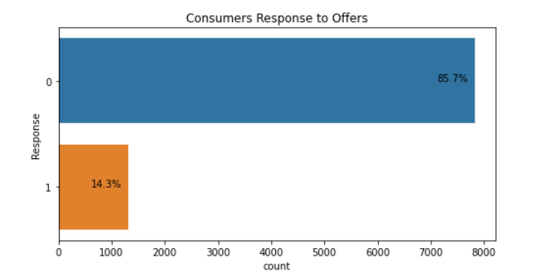
Context
Automotive Insurance Dataset, Synthetic Data – IBM Watson
Policies of consumers expiring within next two months
All consumers were offered a renewal offer
Major Pain Point
14% of the customers accepted the renewal offer
Understanding the lower acceptance rate
Our solution
Regression – Predicting the Customer Lifetime Value
Take targeted actions to increase profitable customer response, retention, and growth
CLV > Cost of acquisition and retention
Classification – Determining whether the customer would respond to the offer
Understanding which consumers would respond negatively and target those
Notes:
Use predictive analytics to analyze the most profitable customers and how they interact.
Knowing each customer’s customer lifetime value helps you know how much you should be spending on customer acquisition. A customer’s acquisition cost could be more than what they spend on their purchase, but if you nurture that relationship, their CLV may grow to an amount that’s well worth the investment. That’s just one of the many reasons why success in the customer-centered economy means understanding the importance of customer lifetime value.

Slide 4
CONTEXT (cont’d)
Our understanding of the Business Problem – framed keeping in mind the different stakeholders
Framing the problem
Objective
How will our solution be used? + Benefits
What are the current solutions/workarounds (if any)?
How would the performance be measured and is the performance measure aligned with the business objective?
What are the comparable problems, and can we reuse tools?
Can this be applicable for other contexts?
What level of manual intervention is required and is human expertise available?
Is full automation possible?
Inspiration Understand customer demographics and buying behavior. Use predictive analytics to analyze the most profitable customers and how they interact. Take targeted actions to increase profitable customer response, retention, and growth.
Target those with higher CLV and who responded no; look at this subset
***Hypothesis: Causal Relationship between our outcome variable (Response) and offer 2 considering offer 2 is the most popular one. We also think there is a
Communicate the hypothesis testing strategy to the right audience: Knowing each customer’s customer lifetime value helps you know how much you should be spending on customer acquisition. A customer’s acquisition cost could be more than what they spend on their purchase, but if you nurture that relationship, their CLV may grow to an amount that’s well worth the investment. That’s just one of the many reasons why success in the customer-centered economy means understanding the importance of customer lifetime value.

Slide 5
Problem Statement – Use Cases
Predicting if a customer will accept the renewal offer or not
Prediction model to pair customers with renewable offer that they are more likely to accept
Identify potential Customer Lifetime Value

Slide 6
HYPOTHESIS
What can be predicted/optimized? – Prediction: CLV ; Classification: Willingness to accept the offer
What actions can be taken?
What are the possible outcomes?
Inspiration Understand customer demographics and buying behavior. Use predictive analytics to analyze the most profitable customers and how they interact. Take targeted actions to increase profitable customer response, retention, and growth.
Target those with higher CLV and who responded no; look at this subset
***Hypothesis: Causal Relationship between our outcome variable (Response) and offer 2 considering offer 2 is the most popular one. We also think there is a
Communicate the hypothesis testing strategy to the right audience: Knowing each customer’s customer lifetime value helps you know how much you should be spending on customer acquisition. A customer’s acquisition cost could be more than what they spend on their purchase, but if you nurture that relationship, their CLV may grow to an amount that’s well worth the investment. That’s just one of the many reasons why success in the customer-centered economy means understanding the importance of customer lifetime value.

Slide 7
Data
DATA ACQUISITION:
What data do we need? How much data do we need?
Source of Data + Reference the source link
Preliminary Check before Data Acquisition:
Check legal obligations and get access authorization, if required
Can the data be used as-it-is/ manipulated?
Ensure sensitive information is deleted/protected (through anonymization)
Check Data Profile (Size and Type of Data)
Sample Test Set
DATA PREPROCESSING:
Feature selection

Slide 8
Data
DATA EXPLORATION:
Exploring manageable size of data (Whole dataset/sample)
Profile of Data:
Name
Type
% missing values
Noisiness and type of noise (outliers etc.)
Type of Distribution
Any other useful parameter
Identification of Target Variables
Data Visualizations
Correlation (Heatmap)
What did we learn?
What transformations are required?

Slide 9
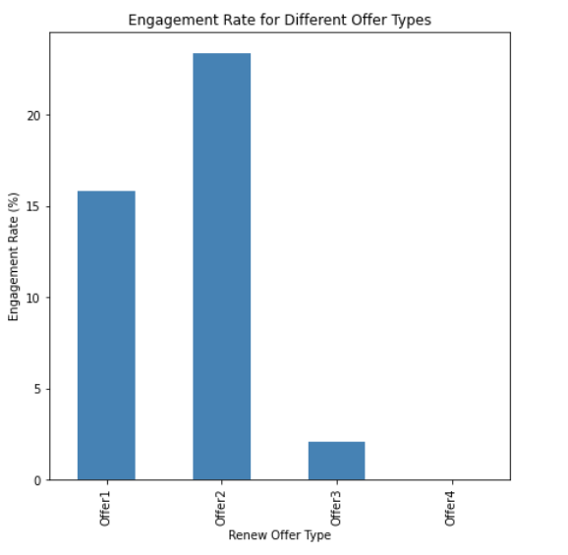
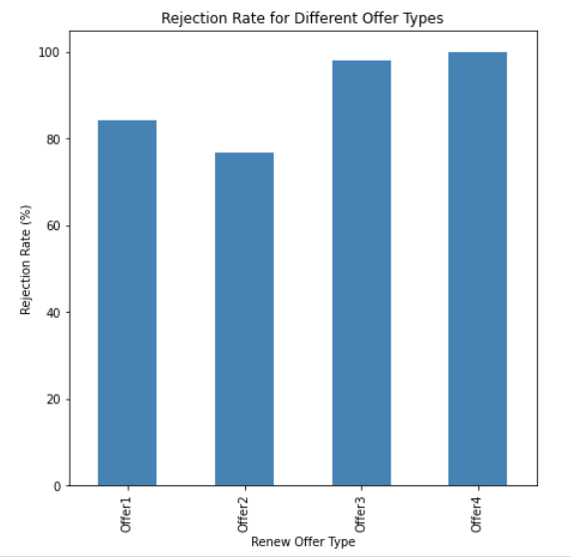
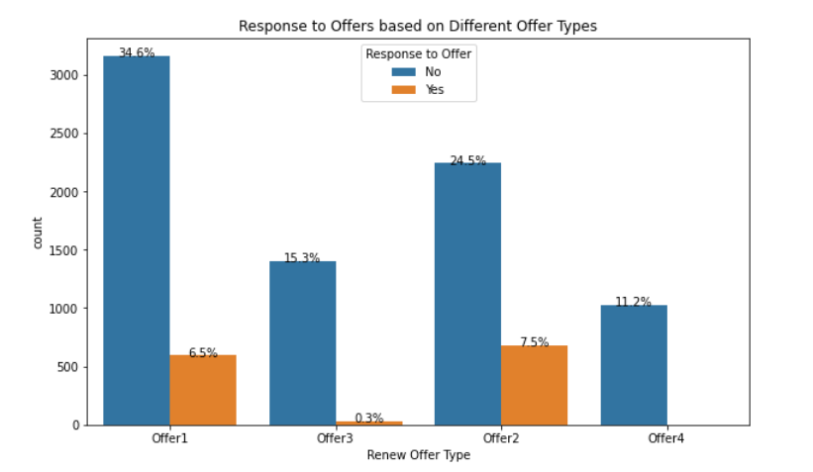
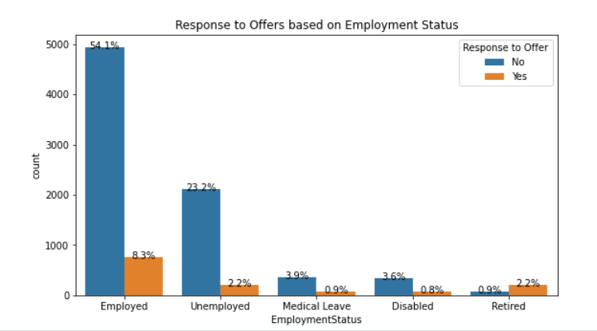
Key insights from data exploration

Slide 10
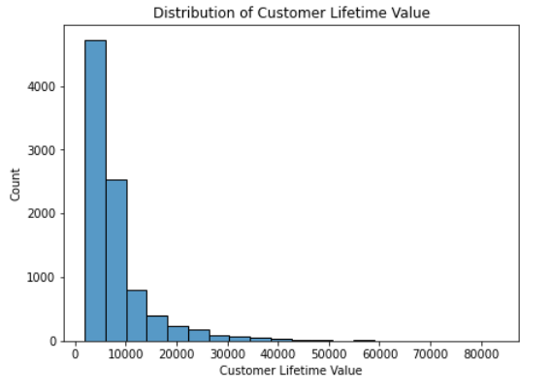

Slide 11
Data
DATA PREPARATION:
Missing Data
Cleaning Data
Outliers + Visualization + What did we do? (remove/fix)
Data Pre-processing
Feature Selection (Collinearity and Dimension Reduction – through PCA, ICA etc.)
Feature Engineering – encoding etc.
Feature Scaling – Standardization/Normalization
Clustering?
Imbalanced Data?

Slide 12
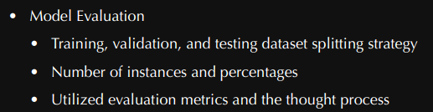
MODEL
Type of model? – Supervised/Unsupervised? Classification (Binary/ Multi-output etc.)/ Regression?
Different models trained and their comparative performance:
N-fold cross validation for each model, mean and std. dev. for N-folds
Most significant variables for each algorithm
Errors made by each model + how can these be removed (more data?)
Fine-tuning of models
Top 3 to 5 models, considering the comparative performance parameters above, benchmarks, simplicity

Slide 13
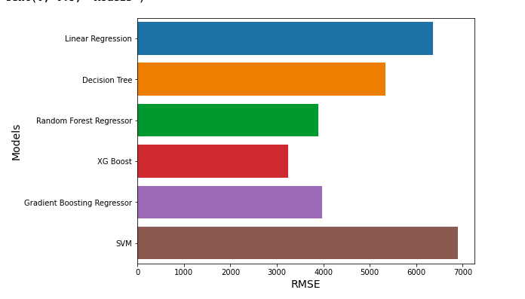
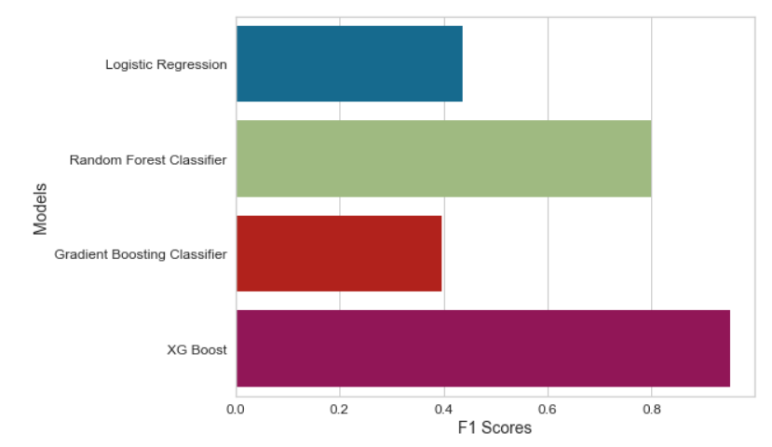
RESULTS
RMSE- Regression
F1 Scores - Classification
XGBOOST performed best for both Regression and Classification tasks, as shown by the RMSE and F1 Scores.
F1 Scores were used as performance metrics as opposed to precision, accuracy and recall because it is better suited for imbalanced data sets.
XGBOOST had the lowest RMSE of 3250 and the highest F1 score of 0.9508.

Slide 14



THREATS TO VALIDITY
Threats due to assumptions
“No” in Response means Customer Lifetime Value is stopped.
Uncertainties and Risks
There may be a relationship between low amounts of Customer Lifetime Value with the Response value “No”, which can skew our predictions.
Data Quality Issue Risks
The lack of data dictionaries made it difficult to make business interpretations.

Slide 15
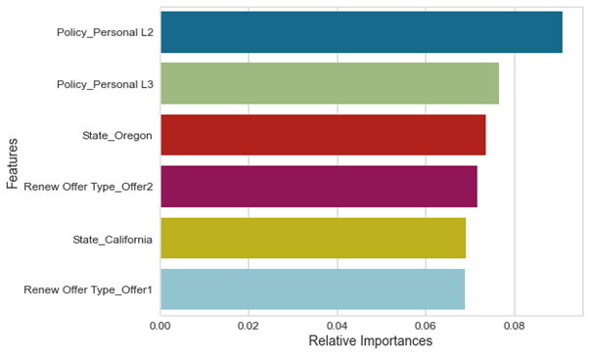
EXPLAINABILITY AND Feature Importance
Feature Importance
Policies were divided into multiple categories, which were themselves divided into 3 partitions: L1, L2 and L3. The Offer type for the renewal of a given policy was divided into 4 partitions.
The graph shows the most impactful features on the classification model.

Slide 16
RESULTS AND CAUSAL INFERENCE
Causal Inference
Treatment Variable | Outcome | P-value | Causal Estimate
Employment Status | Response | 2.05802192e-185 | 0.30227239707480014
Employment Status | Customer Lifetime Value | 0.54563766 | -231.5672853316355
Renewed Offer 2¹ | Response | 1.91191812e-72 | 0.13577096960840376
Renewed Offer 2¹ | Customer Lifetime Value | 2.79475762e-05 | -600.8904175778762
Coverage² | Response | 0.36693648 | 0.011638509408402331
Coverage² | Customer Lifetime Value | 0.1003263 | -406.5270155918706
Income³ | Response | 0.53240536 | -0.008562524931706894
Income³ | Customer Lifetime Value | 0.35978577 | -240.84619017280875
¹ Offer 2 was found to be the most popular offer
² Coverage was either listed as Premium or not
³ Income is listed as true if above average

Slide 17
BUSINESS IMPLICATIONS
Targeting consumers with high CLV who were predicted to respond negatively to offers
Providing other offer options to gauge their interest
Offering Offer 2 to more consumers
Causal Inference Recommendation
Focus on developing similar offers to Offer 2
Focusing on volume

Slide 18
Lessons learnt and next steps
Lessons learnt
Data is not enough to answer the 'why' of the problem
Data overlay maybe required to determine a strategy
Need to SMEs to understand the features/data better
Next Steps (from company's perspective)
Understanding who your customers are and what's driving them
Conducting surveys to determine what kind of offers people would be willing to accept
Understanding the reason of people rejecting the offer
Understanding if giving multiple offers would improve the acceptance rate
Renewal offers should be distributed after understanding different customer segments
Personalizing the type of offers being provided to consumers

Slide 19
Appendix

Slide 20
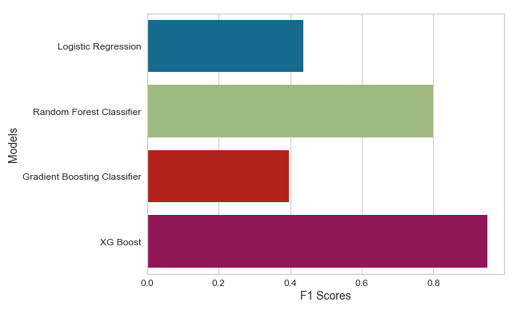
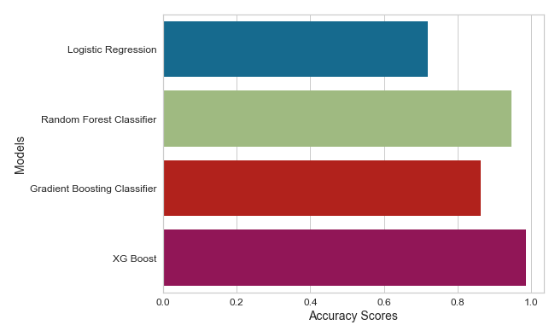
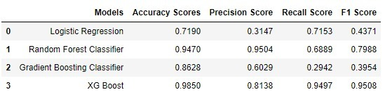
F1 scores and Accuracy scores – Classification

Slide 21
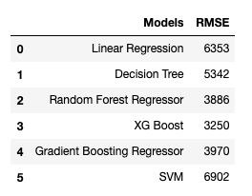
RMSE

Slide 22
Feature importance

